Slide 1


Accident Investigation: An Introduction
It Wasn’t Me!
Presented by:
Kristen Panella, CSP, MS, CHO, CSC
2SAFE Consulting, Inc.

Slide 2



Who is this Guy Anyway?!?!?

Slide 3

Benefits of Incident/Accident Investigation
Prevent future accidents/incidents by identifying and eliminating hazards
Expose deficiencies in process and/or equipment
Maintain worker morale
Greater safety awareness - provides the cornerstone for a effective workplace safety / injury prevention program
Facts gathered in the event of litigation
Reduce injury and worker compensation costs
Notes:
An effective way to prevent injuries and illnesses from recurring is to conduct an investigation to find the hazards that existed that resulted in the injury or illness and take measures to correct or eliminate the hazard(s).

Slide 4
Goals of Accident Investigations
The goals of accident investigation are:
Determine/find the root cause(s)
Take the appropriate corrective action(s)
Prevent a similar accident/incident from happening again
No accident investigation has ever changed what has already happened
Accident investigation should NOT assign blame - it should identify breakdowns in the safety process

Slide 5
Steps in the Accident Investigation Process
Notification
Response
Fact Finding
Analysis
Corrective Action
Follow-up

Slide 6
Definitions - Incident
What Is An “Incident”?
An incident (or Near Miss) is an unplanned and unwanted event which disrupts normal activities and has the potential of resulting in injury, harm, or damage to persons or property (e.g. fall on steps with no injury).
An incident disrupts the work process, does not result in injury or damage, but should be looked as a “wake up call”. It can be thought of as the first of a series of events which could lead to a situation in which may become a loss.

Slide 7
Definitions - Accident
What Is An “Accident”?
An accident is an unplanned and unwanted event definite as to time and place which disrupts normal activities and results in an injury, harm, or damage to persons or property (e.g. fall on steps resulting in a broken ankle).
An accident is NOT “just one of those things” or “just bad luck.”
From experience and analysis accidents are “caused occurrences.”
Accidents are predictable events - they are the logical outcome of hazards.
Accidents are preventable and avoidable - hazards do not have to exist. They are often caused by things people do -- or fail to do.
Accidents don’t have to happen!
Simplified Way to Look At “Incident” vs. “Accident”?
An incident is an accident without loss (injury or damage)
An accident is an incident with loss (injury or damage)

Slide 8
Definitions - Accident
“Incident” vs. “Accident”
An incident is an accident without loss (injury or damage)
An accident is an incident with loss (injury or damage)

Slide 9
Definitions - Occurrence
What is an “Occurrence?”
An occurrence is an accident with the limitation of time removed - an “accident” that is extended over a period of time rather than a single observable happening (e.g. bus mechanic experiencing hearing loss, mold problem from a prolonged roof leak).

Slide 10
“Incident” vs. “Accident”
Fatalities
Severe Injuries
Major Injuries
Near Miss/Close Call
Hazardous Conditions
Accidents
Incidents

Slide 11
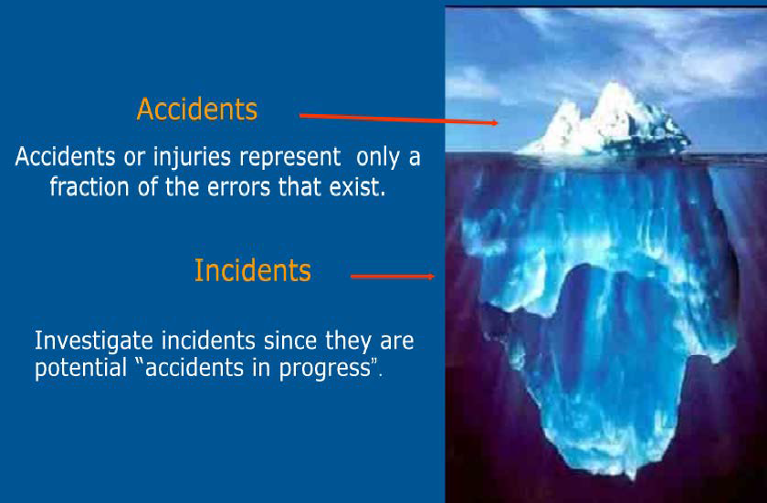
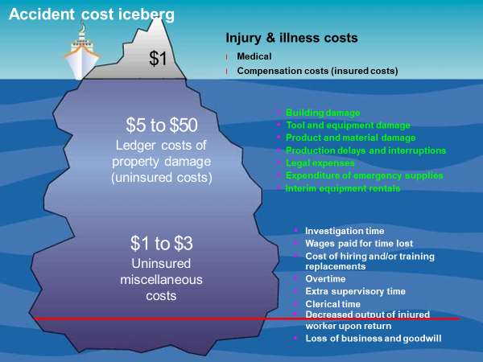
True Costs of Accidents
#4

Slide 12
Occupational Safety and Health Administration
In certain instances, you may need to notify OSHA of your accident:
Fatality
Inpatient Hospitalization
Amputation
Loss of an Eye

Slide 13

Occupational Safety and Health Administration
Employers are Required to:
KEEP RECORDS OF INJURIES AND ILLNESSES
REPORTING AND RECORDING CHECKLIST
All employers are required to notify OSHA when : an employee is killed on the job suffers a work-related hospitalization Amputation loss of an eye A fatality must be reported within 8 hours. An in-patient hospitalization, amputation, or eye loss must be reported within 24 hours.

Slide 14
To Make a Report
Call the nearest OSHA office.
Call the OSHA 24-hour hotline at 1-800-321-6742
Report online
https://www.osha.gov/pls/ser/serform.html

Slide 15

What You Will Need to Report to OSHA
1904.39(b)(2)(i)
1904.39(b)(2)(iii))
The establishment name
The location of the work-related incident

Slide 16

What You Will Need to Report to OSHA (Cont.)
1904.39(b)(2)(iii)
1904.39(b)(2)(iv)
The time of the work-related incident
The type of reportable event

Slide 17

What You Will Need to Report to OSHA (Cont.)
1904.39(b)(2)(v)
1904.39(b)(2)(vi)
The number of employees who suffered
The names of the employees who suffered

Slide 18

What You Will Need to Report to OSHA (Cont.)
1904.39(b)(2)(vii)
1904.39(b)(2)(viii)
Your contact person and his or her phone number
A brief description of the workrelated incident

Slide 19
Steps in the Accident Investigation Process
Notification
Response
Fact Finding
Analysis
Corrective Action
Follow-up

Slide 20
Response
Obtain or ensure medical treatment
1
Eliminate dangerous or obvious hazard
2
Don’t wait for investigation process
Secure the accident scene
3
Control unsafe conditions
Preserve material (critical) evidence
Prepare for possible third-party involvement
Provide appropriate notifications regarding the accident or injury
4
Identify who should be involved in the accident investigation process
5

Slide 21


Fact Finding
Collect / gather accident-related information
Examine / document the accident scene
  Note location of person(s) at the time of the accident
  Note location of objects
  Note conditions (including weather if applicable)
  Take photographs or video (as warranted)
Develop a sequence of events
  Detailed step-by-step description of the accident
  Do not just describe the accident itself, include a description of the events that led up to the accident

Slide 22

Tips for Photographic Documentation
  Always make notes about the photos taken
  Start by taking distance shots first then move in to take closer photos of the scene
  Take photos at different angles (from above, 360 degrees of scene, left, right, rear) to show the relationship of objects and minute and/or transient details such as ends of broken rope, defective tools, drugs, wet areas, or containers
  Take panoramic photos to help present the entire scene, top to bottom ‐ side to side
  Take notes on each photo; these should be included in the incident investigation file with the photos

Slide 23
Tips for Photographic Documentation (Cont.)
  Identify and document the photo type, date/time/location taken, subject, weather conditions, measurements, etc.
  Place an item of known dimensions in the photo to add a frame of reference and scale (for example, a penny or a pack of cards)
  Identify the person taking the photo
  Indicate the locations where photos were taken on sketches
OSHA Fact Sheet. Root Cause: The Importance of Root Cause Analysis During Incident Investigation.(2016). This fact sheet provides guidance for identifying root causes of incidents and/or near misses in order to prevent their recurrence.

Slide 24
Sketching the Scene
OSHA. Incident [Accident] Investigations: A Guide for Employers. (2015). This guidance document provides employers with a systems approach to identifying and controlling the underlying or root causes of all incidents in order to prevent their recurrence.

Slide 25

Continue Your Fact Finding
Interview the injured employee(s) as soon as possible
Identify and interview accident witnesses
Utilize practical, simple approaches
  Who, What, Where, When, How, WHY
Keep probing for more information
Don’t jump to conclusions or recommendations too quickly
Remember that accidents rarely result from a single cause - they usually result from network of multiple causes

Slide 26
Interviewing
When is it best to interview? Why?
Who should we interview? Why?
Where should we conduct the interview?
As soon as possible
When it is safe
Representation
Injured
Witnesses
Supervisors
Scene of the accident
Office
Phone

Slide 27
Analysis – What and Why Factors
WHAT happened?
Identifying/determining the surface cause(s)
What were the conditions?
What was the employee doing?
WHY did it happen?
Identifying/determining the root cause(s)

Slide 28
Unsafe Behaviors
Most hazardous conditions are the result of an unsafe behavior(s) that produced them. Examples of unsafe employee/manager behaviors include:
Failing to comply with rules
Using unsafe methods
Taking shortcuts
Horseplay
Failing to report injuries
Failing to report hazards
Allowing unsafe behaviors
Failing to train or inadequate training
Failing to supervise
Failing to correct
Excessive workload
EMPLOYEE
MANAGER

Slide 29
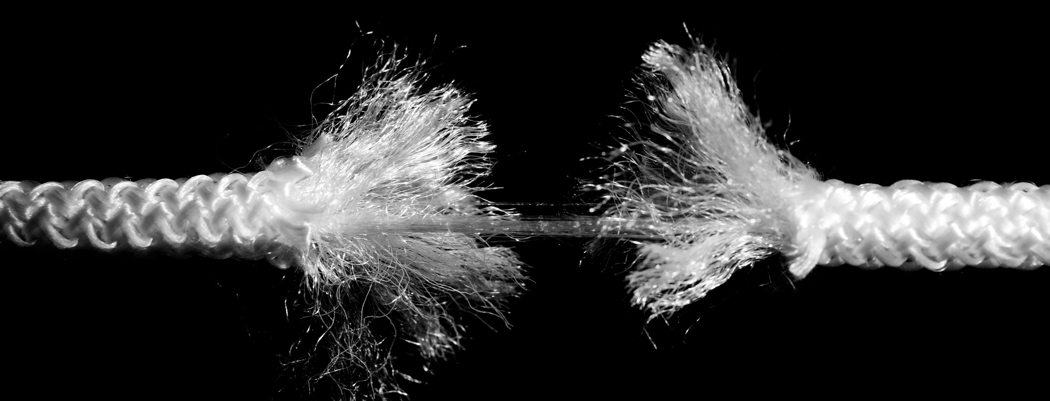
Analysis – Root Cause
The root causes for accidents are the underlying system weaknesses that have somehow contributed to the existence of hazardous conditions and unsafe behaviors that represent surface causes of accidents.
A root cause is the cause that, if corrected, should prevent recurrence of this and similar occurrences.

Slide 30
Analysis - Multiple Root Cause Analysis
“WHY” Analysis
Why
Why
Why
Why
Why

Slide 31

Corrective Action
Developing corrective or preventative actions is the most important step in the accident/incident investigation process.
All the efforts leading up to this step culminate with recommendations to prevent similar accidents from happening in the future.
If root causes are not corrected, it is only a matter of time before a similar accident occurs.

Slide 32
Follow-up
Establish
Establish a timeline and process to follow-up on corrective actions
Who is responsible for implementing?
Who is responsible for following-up on that person?
Evaluate
Evaluate to find out or determine if the corrective actions are effective in preventing similar accidents from occurring
Modify or revise
Modify or revise corrective actions as needed
Share / communicate
Share / communicate the results

Slide 33
Collect Evidence at the Scene
Incident information is collected through interviews, document reviews, and other means. In addition to interviews, investigators may find other sources of useful information. These include:
Equipment manuals
Industry guidance documents
Company policies and records
Maintenance schedules, records and logs
Training records
Audit and follow‐up reports
Enforcement policies and records
Previous corrective action recommendations

Slide 34
Collect Evidence at the Scene
Sample list of items to use to conduct the investigation:
Camera
Charged Batteries (for phones, cameras, equipment, etc.)
Video / Audio recorder
Measuring devices in various sizes
Leveling rod
Clipboard and writing pad
Pens, pencils, markers
Graph paper
Straight‐edge ruler (can be used as a scale reference in photos)
Incident investigation forms
Flashlight
Strings, stakes, warning tape
Photo marking cones
Personal protective equipment: gloves, hat, eyewear, ear plugs, face mask, etc.
Magnifying glass
High visibility plastic tapes to mark off area
First aid kit
Latex gloves
Sampling [holding] containers with seals (Various types: bags, jars, containers, etc.)
Identification tags
Variety of tape: Scotch, masking, duct
Compass
Carpenter’s ruler
Hammer
Paint stick (yellow/black)
Chalk (yellow/white)
Protractor
Clinometer

Slide 35
Interviews
Since some questions will need to be designed around the interviewee, each interview will be a unique experience. When interviewing injured workers and witnesses it is crucial to reduce their possible fear and anxiety, and to develop a good rapport. When conducting interviews, investigators should:
Conduct the interview in the language of the employee/interviewee; use a translator if needed
Clearly state that the purpose of the investigation and interview is fact‐finding, not fault‐finding
Emphasize that the goal is to learn how to prevent future incidents by discovering the root causes of what occurred
Establish a climate of cooperation, and avoid anything that may be perceived as intimidating or in search of someone to blame for the incident

Slide 36
Interviews
When conducting interviews, investigators should:
Let employee know that they can have an employee representative (such as, labor representative)
Ask the individuals to recount their version of what happened
Not interrupt the interviewee
Take notes and/or record the responses; interviewee must give permission prior to being recorded
Have blank paper and/or sketch available for interviewee to use for reference
Ask clarifying questions to fill in missing information
Reflect back to the interviewees the factual information obtained; correct any inconsistencies
Ask the individuals what they think could have prevented the injury/incident, focusing on the conditions and events preceding the injury

Slide 37

Start Your Investigation

Slide 38
Start Your Investigation - Who
Who was injured?
Who saw the incident?
Who was working with the employee?
Who had instructed/assigned the employee?
Who else was involved?
Who else can help prevent recurrence?

Slide 39
Root Cause Analysis
Step 1 – Event Description
In this section list factually exactly, what happened. Items leading up to the accident, during the accident and post accident.
Step 2 – List the Investigation Team
List who is doing this RCA, their titles and what company they work for.
Step 3 – Investigation
In this section list how the investigation was completed, who did what, what forms were filled out, who was notified, etc.

Slide 40
Root Cause Analysis
Step 4 – Finding and Root Cause
State what the investigation team had determined as the root causes. Remember there can be and usually are more than one.
Step 5 – Corrective Actions
What actions will be implemented to make sure an accident of this type never happens again. List responsible parties and expected completion date.

Slide 41

Corrective Action
Developing corrective or preventative actions is the most important step in the accident/incident investigation process.
  The investigation is not complete until corrective actions are implemented that address the root causes of the incident. Implementation should entail program level improvements and should be supported by senior management.

Slide 42
Corrective Action
Specific corrective actions address root causes directly; however, some corrective actions can be general, across‐the‐board improvements to the workplace safety environment. Sample global corrective actions to consider are:
Strengthening/developing a written comprehensive safety and health management program
Revising safety policies to clearly establish responsibility and accountability
Revising purchasing and/or contracting policies to include safety considerations
Changing safety inspection process to include line employees along with management representatives

Slide 43


Let's Review Some Actual Accident Investigations

Slide 44
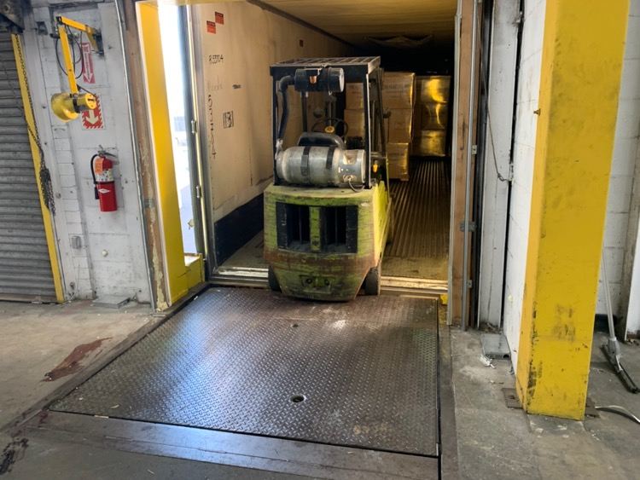
Accident #1 – Not My Forklift
Two employees were operating a poorly functioning forklift that led to a foot being amputated.

Slide 45

Event Description
Two temporary employees from a temp employee agency were instructed to travel to the warehouse and offload a trailer by their supervisor. In the trailer were pallets of boxed plastic bottles to be off loaded into the warehouse. The Temp employees were instructed to use only the electric pallet jack provided by the company and not the forklift that was left onsite by the building owner.
However, the Temp employee used the forklift that morning to offload the trailer. At approximately 10:30am that morning Phil called James over from the warehouse to help him raise the loading dock leveler (or ramp from the building into the truck trailer). The leveler to unload the trailer raises up (due to a defect) when there is no weight on it, so it does not allow for free movement in and out of the trailer. James went over to help him with the leveler. To raise the leveler, one needs to pull a chain from the leveler to control the ramp going up and down. The ramp chain doesn’t always work, so Phil left the forklift in the trailer and got off to come help James with the leveler. Phil was standing with his back to the forklift in the trailer and James was standing in front of Phil pulling the chain.

Slide 46
Event Description
Moments later, James alleges that the forklift started beeping. The forklift was stopped in the trailer on a bit of an incline. The forklift started rolling down the trailer. James yelled at Phil to get out of the way but since his back was towards the forklift, he wasn’t aware of what was happening. James ran over and pushed Phil out of the way but by then it was too late, and the forklift amputated Phil’s left foot. The foot was pinned between the forklift and the ramp. Phil laid on the floor and James called the police at 10:36 am. James ran outside to the truck driver and told him what had happened and asked him to come help. James called his supervisor.
James took off his sweater and wrapped it around Phil’s foot and kept it there until the police came. The police arrived in about 5 minutes. When they arrived, they asked James to move the forklift so they could recover Phil’s foot. The foot was stuck in between the truck trailer and the ramp. James moved the forklift and the police were able to recover the foot. The ambulance arrived about 15 minutes after the call to the police and they took Phil to the hospital.
The local OSHA office was contacted, and a Compliance Safety and Health Officer came onto the site. OSHA’s Compliance Office met with James, the supervisor, and a Human Resources representative. They reviewed the incident and surveyed the entire building.

Slide 47


Investigation Findings
The investigation team visited the site to complete an accident investigation. The scene was preserved from the day before. The investigative team, with help from the supervisor, ran through the events from the previous day. Both Phil and James normally work at a different facility and only work at this facility for a few hours out of the day.

Slide 48
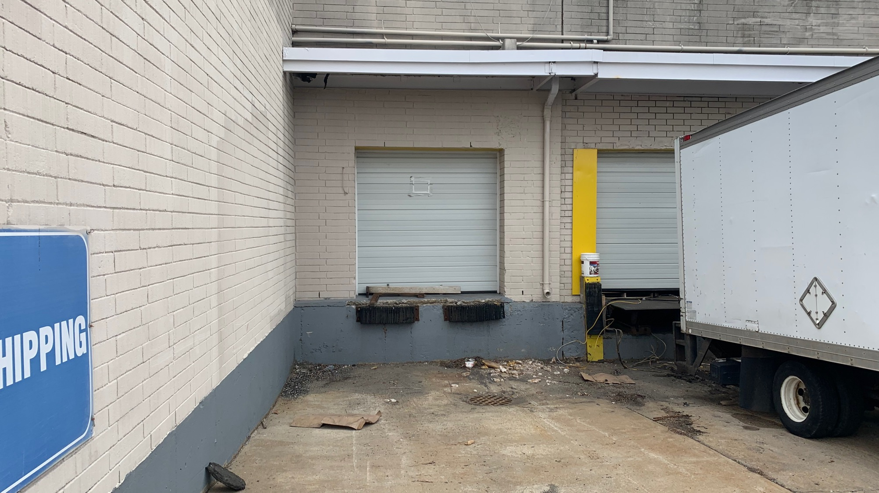
Investigation Findings – Truck Trailer
The truck trailer was observed to be on an incline leading to the building. This is typical of truck loading areas but lead to the forklift rolling.

Slide 49
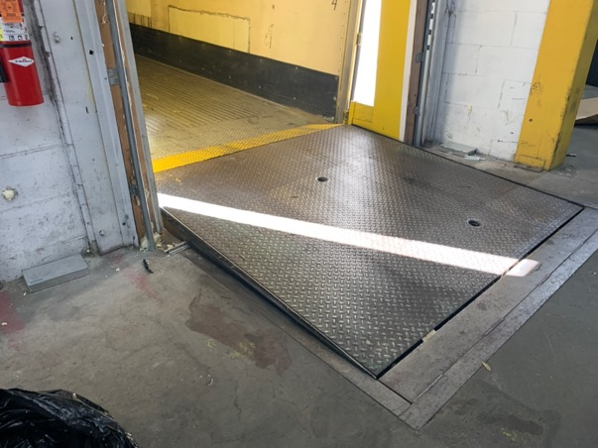
Investigation Findings – Loading Dock
The loading dock leveler was not in proper working order. It was observed to not say in the down position which would make it impossible to freely drive in and out of the truck trailer. It was determined the leveler pistons were inoperable. Dead bolt locks were installed to hold the leveler down, but one was broken, and one was not used. The chain that releases the leveler tab was also missing. All the loading dock levelers in the building had the same issue to some degree.

Slide 50
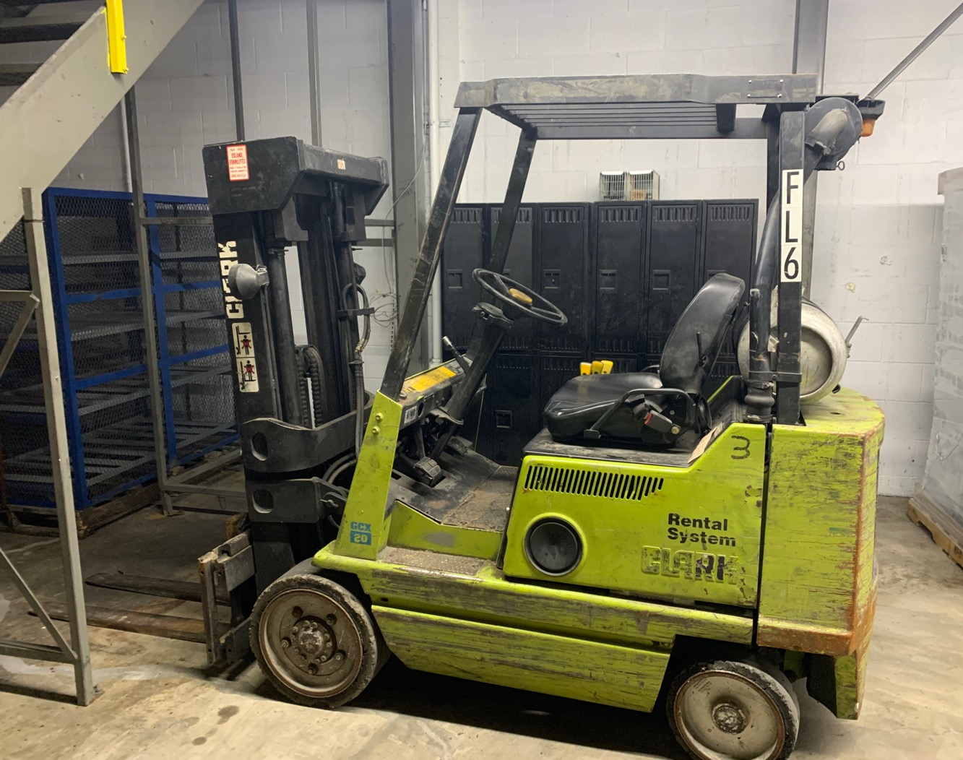
Investigation Findings – Forklift
The forklift was not owned by the company but owned by the building owner. An electric pallet jack was evaluated by supervisors to be sufficient for the tasks at the facility and provided to the employees. Phil was provided the company’s Powered Industrial Truck Safety Training prior to working at the facility.

Slide 51
Investigation Findings – Forklift
The forklift was never inspected, not maintained, and not part of the company’s forklift safety program. The forklift was observed to be in poor operating condition.
One of the investigators tried to reenact the incident and several observations were made:
The gas petal was missing, only a metal rod could be used to press the accelerator
The breaks were inoperable
The parking brake was inoperable
The forklift stalled multiple times during start-up and during operation
Due to the incline the forklift could not be stopped from rolling within the trailer
To keep the forklift parked inside the trailer and not roll backwards, the investigator needed to keep the forklift in drive, however the forklift stalled and rolled backwards on each attempt
When the forklift rolled backwards, both while running and while stalled, there was no beeping from the forklift

Slide 52
Investigation Findings
What could have been done to prevent this injury:
Phil was told on several occasions that the forklift was not the company’s and to not use the forklift. He purposefully disobeyed his supervisor’s orders to not use the forklift. Supervisors evaluated the need for an electric pallet jack for the task. A forklift was not needed. Phil failed to identify that the forklift was in poor condition and was not safe to use. Additionally, he did not follow the guidance provided to him as part of the company’s Powered Industrial Truck safety program and employee training.

Slide 53
Investigation Findings
Were safety programs in place and used? If not, what was wrong:
The company has a forklift safety and employee training program in place. This program and its training were not followed by Phil. Prior to using a forklift a safety checklist needs to be completed. Phil states that he is aware that the company uses a safety checklist but did not complete one at this facility. Phil states that he also had forklift training from his second job which provides training every 6 months. Phil also states that he has over 30 years of forklift experience. Phil did not comprehend the seriousness of using a defective forklift.

Slide 54
Investigation Findings
Why did the unsafe conditions exist:
The owner of the building left their forklift at the leased property. Supervisors identified that this was not the company’s forklift and was not to be used. The work at this facility was evaluated and a forklift was not needed. An electric pallet jack was provided to the employees for their use.

Slide 55
Investigation Findings
Why did the unsafe acts occur:
An employee did not follow the company’s safety rules and training. The employee directly disobeyed his supervisor.

Slide 56
Corrective Actions
1. Revise company policies that under no circumstances are temporary employees allowed to work without direct supervision.
2. Revise company safety policies and preventative maintenance to include leased and/or temporary space.
3. Reevaluate the need for a forklift at this facility.
4. Request that the forklift at this facility be removed by the owner. Until that time the company will lockout the forklift and post signage to make sure it cannot be operated.
5. Audit all forklift checklists for completion and accuracy.
6. Audit all forklift parking brakes to make sure they are sufficiently operable.
7. Audit to ensure all forklift drivers are trained.
8. Audit Forklift Training program for its effectiveness and employee competency. Highlight the seriousness of operating a defective forklift.
9. Audit discipline policy for temporary employees and its effectiveness.

Slide 57
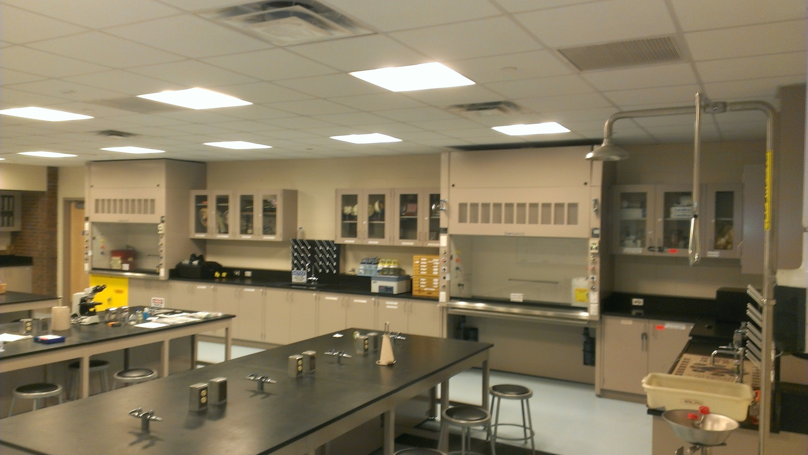





Accident #2 – Hydrochloric Acid Incident:
Hydrochloric acid incident in a laboratory burned an employee’s skin and could have hurt others.

Slide 58
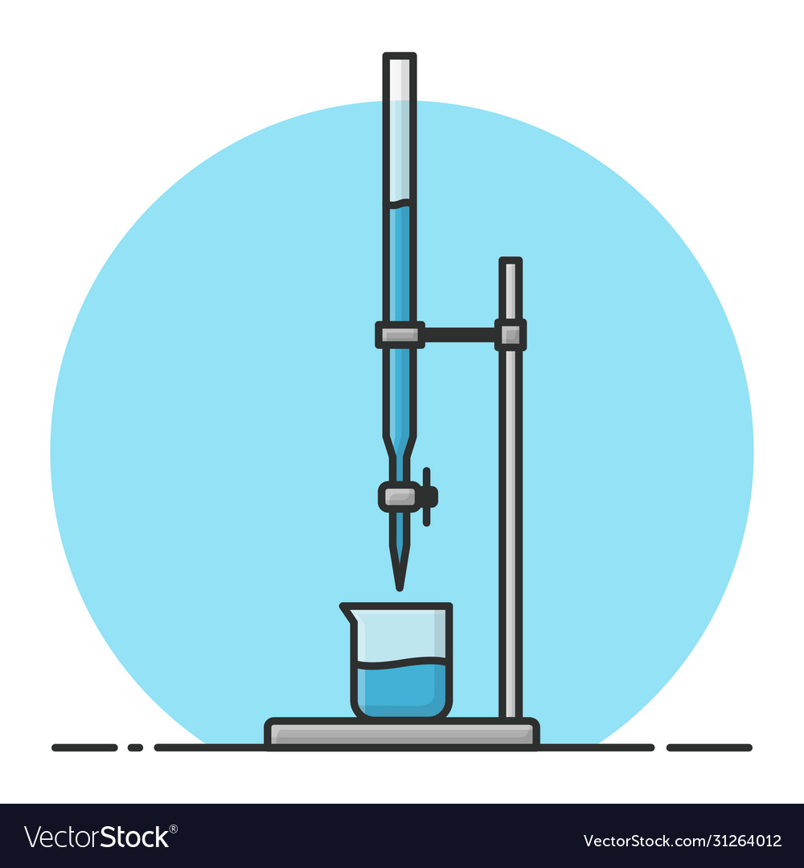
Event Description:
In an early morning class, a professor was demonstrating titrating hydrochloric acid in a chemistry experiment.
While using a burette to add HCL to water for dilution the burette either tipped over or was dropped slashing the professor on the arm and spilling on the lab bench and floor.
The professor received chemical burns to their hand and forearm.

Slide 59

Room for Improvement:
At the concentration used in this experiment, hydrochloric acid is corrosive to eyes and skin and thus instructors and students should be required to wear chemical splash goggles and protective gloves
Not the proper Eye Protection
Not the proper Hand Protection
Not the proper Body Protection
Not the proper Environment

Slide 60
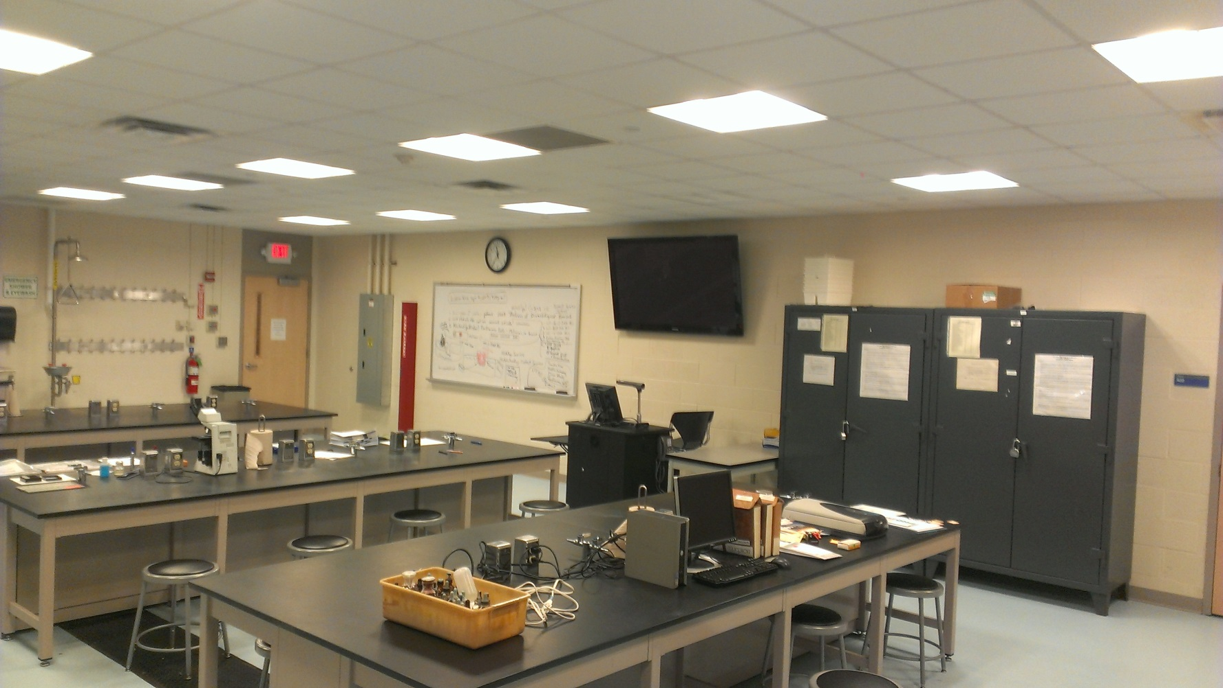
Investigation Findings:
At the concentration used in this experiment, hydrochloric acid is corrosive to eyes and skin and thus instructors and students should be required to wear chemical splash goggles and protective gloves.
The temperature of the reaction system rapidly increases after the induction period. If the reaction system is left unattended after completing the required measurements, the temperature can reach 100 °C and care must be taken when handling the reaction system once the measurements have been completed.
Hydrogen gas is rapidly generated and released during the thermal runaway reaction. The experiment should be performed in a lab with sufficient ventilation and all ignition sources should be removed from the work area to avoid the possibility of fire or explosion.
The acidic waste should be collected in an appropriately labeled waste container and disposed of according to local regulations.

Slide 61
Investigation Findings:
Are Nitrile Gloves Chemical Resistant?
Nitrile is a synthetic rubber with excellent flexibility, puncture resistance, strength and abrasion resistance. They also resist many chemicals making them great for general-duty short-duration tasks.
Are Nitrile Gloves Acid Resistant?
Nitrile gloves are resistant to alkaline solutions, as well as certain acidic solutions. However, if you encounter a strong alkaline solution, it is possible that the glove material may break down and deteriorate upon handling. Overall, nitrile gloves acid resistance is very good in comparison to latex gloves and vinyl gloves.
For this experiment, we found 4 mil nitrile glove is only good up to 37% HCL. We recommend 15 mil.
Though a lab coat is not considered acid resist it offers more protection than short sleeves.

Slide 62



Root Cause:
Education – The professor needs to have a better understanding of the hazards associated with the experiments they are conducting.
Personal Protective Equipment – When performing this type of experiment the professor (and their students) should be wearing the following; lab coat, goggles, and chemical resistant gloves (designed for acid).
Environment – to avoid an acid spill on the lab bench and floor this professor had the opportunity to complete the experiment in a fume hood.

Slide 63
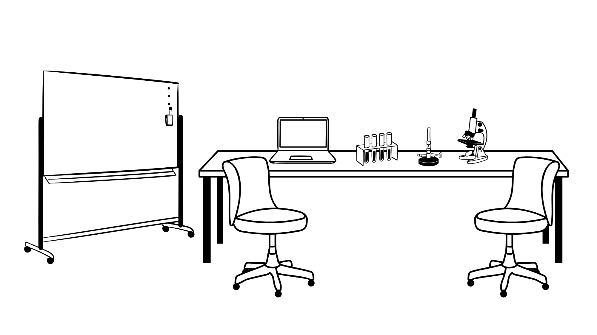
Corrective Action:
Professor to retake Hazard Communication Training and Laboratory Safety Training
Standard issue clothing in the laboratory is as follows:
  Work shirt that covers the upper torso and arms.
  Lower body clothing that covers the entire leg to the ankle (e.g., pants, skirt, coveralls, lab coat) and fully protects exposed skin.
  Closed-toe shoes that cover the top of the foot and are made of leather or synthetic leather or another material that resists rapid penetration by spilled liquids or sharps.
  In laboratories where a fire danger is present, avoid clothing made of synthetic fibers like nylon, polyester, polypropylene or acrylic, which can melt if ignited. Wear less flammable natural fibers, such as wool, cotton, jute, flax and silk.

Slide 64
Corrective Action:
3. Standard personal protective equipment
  Lab coat
  Eye protection
  Safety spectacles with side shields
  Goggles for handling chemicals that can cause eye damage
  Supplement goggles with a face shield when risk of injury is great
  Gloves
And if necessary:
  Hearing protection
  Respirator

Slide 65
Corrective Action:
4. Use of a Fume Hood
  Capture hydrochloric and hydrogen Gas
  Help avoid spills

Slide 66

Summary
Every accident is different and may require a unique approach. Don’t hesitate to be creative and consistently ask the very important question….Why?
Investigating a worksite incident- a fatality, injury, illness, or close call- provides employers and workers the opportunity to identify hazards in their operations and shortcomings in their safety and health programs. Most importantly, it enables employers and workers to identify and implement the corrective actions necessary to prevent future incidents.

Slide 67
Additional Resources
OSHA website: http://www.osha.gov and OSHA offices (you can call or write)
  Incident Investigation Webpage http://www.osha.gov/dcsp/products/topics/incidentinvestigation/index.html
  Injury and Illness Prevention Programs Webpage
    http://www.osha.gov/dsg/topics/safetyhealth/index.html
    http://www.osha.gov/Publications/OSHA3665.pdf
    http://www.osha.gov/dsg/topics/safetyhealth/OSHAwhite‐paper‐january2012sm.pdf
National Institute for Occupational Safety and Health (NIOSH) – OSHA’s sister agency
Washington State Department of Labor & Industries. Accident Investigation Basics. (2009).
UK Health and Safety Executive
Investigating Accidents and Incidents: A Workbook for employers, unions, safety representatives, and safety professionals. 2004. http://www.hse.gov.uk/pubns/hsg245.pdf

Slide 68
Thank You
2safeconsulting.com

